Slide 1
COLLEGE CLASS PRESENTATION
Front-End & Database Architecture
Kernel Hotel Web System
Establishing the relationship between HTML, CSS, JavaScript, PHP, and MySQL.
TEAM NAME
PRESENTED BY
The Kernels
Karly Leach & Haley Fortier

Slide 2



SYSTEM ARCHITECTURE
Project Overview & Platform Separation
Public Portal
Admin Control Panel
Data Foundation
Guest-facing pages for hotel exploration and reservations.
Back-office operations for hotel staff management.
Relational MySQL store managed via PHP PDO.
Home & Rooms: Live room catalog
Dashboard: Central operational metrics
Rooms: Core kernel table entity
Bookings: Real-time date availability
Foreign Keys: Enforced referential integrity
Guest Reviews: Past-stay verified reviews
Reservations: Booking state updates
Guests & Reviews: Moderate guest records
Security: Prepared SQL queries

Slide 3

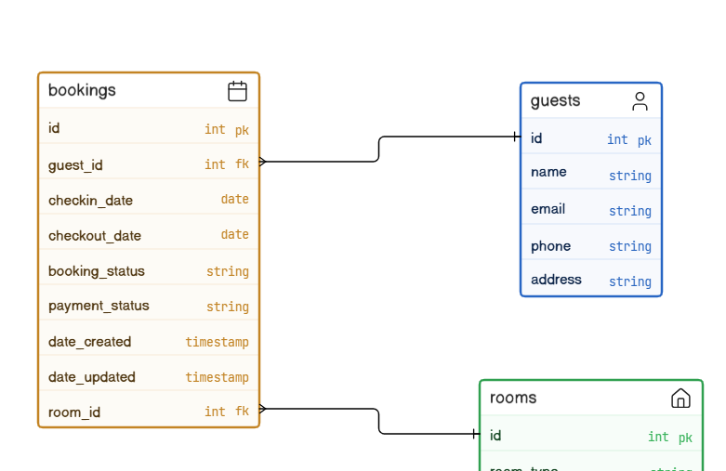
DATABASE MODELING
ER Diagram: Prioritizing "Rooms" as the Kernel
The "Rooms" Pivot Shift
While guests seem central initially, Rooms are the true kernel. Almost every transaction binds to physical room capacity.
Relational Connectors
Bookings Table acts as the junction connecting and foreign keys.
guest_id
room_id
Review Integrity Link
Reviews Table stores reviewer emails to cross-reference checkout dates in Bookings before approving feedback.

Slide 4
DATA STRUCTURES
Core Tables & Schema Constraints
Rooms
KERNEL
Guests
ENTITY
Bookings
JUNCTION
Reviews
VERIFIED
id: INT PK AUTO_INC
id: INT PK AUTO_INC
id: INT PK AUTO_INC
id: INT PK AUTO_INC
room_type: VARCHAR(50)
name: VARCHAR(100)
guest_id: INT FK
reviewer_info: VARCHAR
price: DECIMAL(10,2)
email: VARCHAR(150)
room_id: INT FK
rating: INT (1-5 CHECK)
amenities: VARCHAR(255)
phone: VARCHAR(20)
checkin/out: DATE
review_text: TEXT
availability_status: VARCHAR
mailing_address: VARCHAR
booking_status: VARCHAR
approval_status: VARCHAR

Slide 5
PROJECT ORGANIZATIONAL STRUCTURE
Modular Front-End File Hierarchy
Includes Folder (includes/)
kernel-hotel/
Holds reusable templates like header.php and footer.php to eliminate redundant HTML code across views.
index.php & rooms.php
book.php & process_booking.php
admin/
├── dashboard.php
Admin Isolation (admin/)
└── manage_reservations.php
Groups management pages together, allowing centralized access checks and simplified folder-level administrative routing.
includes/
├── db_connect.php
├── header.php
└── footer.php
Centralized Database Config
css/ & js/
db_connect.php provides a single point of failure and connection configuration for all database queries.

Slide 6
TECH STACK PIPELINE
Connecting HTML, CSS, JavaScript & PHP
HTML5
CSS3
JavaScript
PHP & MySQL
Defines the core UI structure, booking forms, room cards, and DOM containers.
Maintains visual layout, responsive grids, and brand aesthetics via styles.css.
Handles client-side date input validation, UI feedback, and immediate field checks.
Processes business logic server-side and queries MySQL for room persistence.

Slide 7
BACKEND INTEGRATION
Establishing the MySQL Connection
// includes/db_connect.php
Prepared Statements
$host = 'localhost';
All user inputs are bound safely to prevent SQL injection risks across reservation forms.
$db = 'kernel_hotel';
$user = 'root';
try {
$pdo = new PDO("mysql:host=$host;dbname=$db", $user, $pass);
$pdo->setAttribute(PDO::ATTR_ERRMODE, PDO::ERRMODE_EXCEPTION);
Automated Timestamps
} catch (PDOException $e) {
MySQL triggers update automatically on row modification.
die("Database connection failed: " . $e->getMessage());
date_updated
}

Slide 8


TECHNICAL CHALLENGE 01
Handling Overlapping Booking Dates
Client-Side Validation (JS)
Server Source of Truth (PHP)
JavaScript provides instant user notifications, enforcing check-out dates to be strictly later than check-in dates prior to form submit.
PHP executes SQL queries against active booking records in MySQL to guarantee a room cannot be double-booked for overlapping dates.

Slide 9
TECHNICAL CHALLENGE 02
Verifying Unauthenticated Guest Reviews
STEP 01
STEP 02
STEP 03
Review Submission
Stay Verification
Approval Queue
Visitors enter their email, rating (1–5), and review text on the public reviews page.
PHP queries Bookings to verify the email matches a completed stay with a past checkout date.
Verified feedback enters pending status until manually approved by hotel staff.

Slide 10


PROJECT REFACTORING
Scope Refactoring & Database Optimization
Pruned Contact Requests
Streamlined Auth Scope
Removed the standalone Contact Requests Table to eliminate unused data structures and keep the schema strictly focused on core room bookings.
Removed password hash dependencies and role-based access rules from staff records to align with project requirements and prevent complexity bloat.

Slide 11
SUMMARY & RESULTS
Key System Accomplishments
100%
Zero
Modular
Data Integrity
Double Bookings
Code Structure
Enforced via foreign keys and sanitized queries.
PHP logic guarantees date range exclusivity.
Shared includes eliminate repetitive templates.

Slide 12

Questions & Discussion
Thank you for your time! We welcome feedback on our web architecture.
Kernel Hotel System • The Kernels (Karly Leach & Haley Fortier)

